Slide 1

COLUMBIA ASIA HOSPITAL
Hospital Performance
& Patient Analysis
Power BI Project Presentation
Prepared By
Abhishek Kumar Singh
Date – 14/08/2026

Slide 2

| Introduction
Columbia Asia Hospital stands as a beacon of healthcare excellence, serving thousands of patients with dedication and care. The hospital’s latest performance report paints a vivid picture of its operations, shedding light on key metrics, patient satisfaction, and financial health.
The report emphasize on the following areas :
  Assess the Hospital Revenue generation
  Insights about the suitable departments for new hires
  Strategies suggestions for patient discounts

Slide 3
Executive Overview
The dashboard focuses on revenue, departments, patient flow and discount strategy.
TOTAL REVENUE
PATIENTS TREATED
DOCTORS
ADULT REVENUE SHARE
₹509.31M
9,216
22
57.13%
Reported hospital revenue
Reported annual patient count
Across 7 departments
Age 20–64
Business questions answered
Core Power BI analysis areas
• Which departments generate the most revenue?
✓ Revenue performance
• Where should additional doctors be considered?
✓ Department & doctor capacity
• Which departments have higher appointment fees / waiting time?
✓ Patient demographics
• Which patient segments and periods could support targeted discounts?
✓ Monthly visit trend
✓ Discount / retention strategy

Slide 4
Hospital Revenue Generation
Revenue is concentrated in Orthopedics and General Practice.
TOP REVENUE DEPARTMENT
Orthopedics
₹172.94M
SECOND HIGHEST
General Practice
₹164.07M
TOP TWO COMBINED
₹337.01M
≈66% of reported revenue

Slide 5
Department Appointment Fee Insights
Appointment fees vary considerably across departments.
Highest
Appointment fee: Neurology — ₹1,500

Slide 6
Patient Waiting Time
Maximum patient wait time is 60 minutes across all departments.
MAXIMUM WAIT
HIGHEST AVERAGE WAIT
LOWEST AVERAGE
60 min
37 min
35 min
Across all departments
Neurology & Physiotherapy
Several departments

Slide 7
Top Revenue-Generating Departments
The revenue mix shows a strong concentration in two departments.
Key takeaways
1. Orthopedics contributes ₹172.94M (33.96%).
2. General Practice contributes ₹164.07M (32.21%).
3. Neurology and Cardiology are the next major contributors.
Business implication: protect capacity in leading departments while evaluating growth opportunities in mid-tier specialties.

Slide 8
Department for New Hires
Hiring decisions should consider patient volume, revenue contribution and existing doctor capacity.
Department | Doctors | Patients | Revenue
General Practice | 3 | 7240 | ₹164.07M
Orthopedics | 4 | 995 | ₹172.94M
Physiotherapy | 4 | 276 | ₹16.59M
Cardiology | 3 | 248 | ₹68.37M
Neurology | 3 | 193 | ₹72.80M
Gastroenterology | 4 | 178 | ₹9.78M
Renal | 3 | 86 | ₹4.76M
Priority signal: General Practice has the largest patient volume by far, while Orthopedics combines high revenue with high patient volume.

Slide 9
Patient Revenue by Age Group
Adults aged 20–64 account for the largest share of reported revenue.
HIGHEST REVENUE SEGMENT
Adult (20–64)
₹290.97M
SHARE OF TOTAL REVENUE
57.13%
Adults 20–64
Use age segmentation to tailor loyalty, preventive-care and service-package offers.

Slide 10
Patient Visit Trend Throughout the Year
Monthly visits fluctuate considerably, with a reported 4.68% decline from January to December.
JANUARY
513
Starting point
PEAK MONTH
August — 1,024
Highest reported visits
DECEMBER
489
End point

Slide 11
Patient Discount Strategy
The reference recommends targeted rather than blanket discounting.
Prompt payment
Offer discounts for bills settled within a defined time window.
Bundled packages
Create discounted packages for related services or treatments.
Loyalty program
Reward frequent patients to improve retention and satisfaction.
Senior benefits
Offer targeted benefits acknowledging senior-care needs.
Referral program
Reward existing patients who bring in new patients.

Slide 12
Where to Target Promotions
The supplied reference highlights specific periods and the adult segment for targeted engagement.
Target segment
Recommended approach
Adults (20–64) are the strongest revenue segment and represent 57.13% of total revenue.
• Test offers before scaling
• Measure redemption and repeat visits
Target periods
• Protect margins on high-demand services
Consider seasonal promotions particularly during January–March and November–December, as suggested in the reference.
• Compare campaign periods against baseline

Slide 13
POWER BI DASHBOARD STORY
01
02
03
MAIN
DOCTORS
PATIENTS
Hospital-wide KPIs, revenue and operational overview
Department capacity, doctors, patient load and revenue
Patient demographics, visits and engagement insights
Interactive Power BI view
Interactive Power BI view
Interactive Power BI view
The presentation mirrors the reference structure while turning the analysis into an interview-ready business story.

Slide 14
Key Recommendations
Translate the dashboard findings into practical management actions.
1
Protect high-revenue departments
Maintain capacity and service quality in Orthopedics and General Practice.
2
Review General Practice capacity
The very high patient volume suggests a strong case for capacity planning.
3
Investigate waiting time
Neurology and Physiotherapy show the highest average waits at 37 minutes.
4
Use targeted promotions
Focus loyalty, bundles and seasonal offers on measurable segments and periods.
5
Monitor monthly demand
Use the Power BI trend page to spot peaks and plan staffing accordingly.

Slide 15
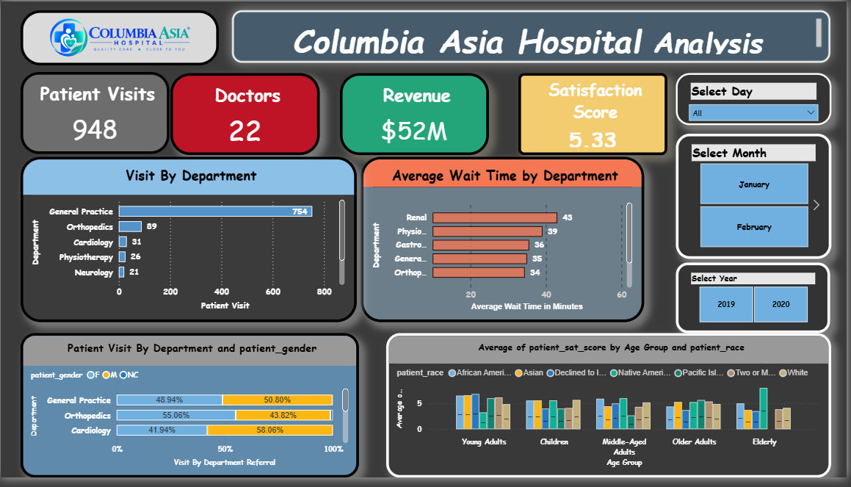

Slide 16
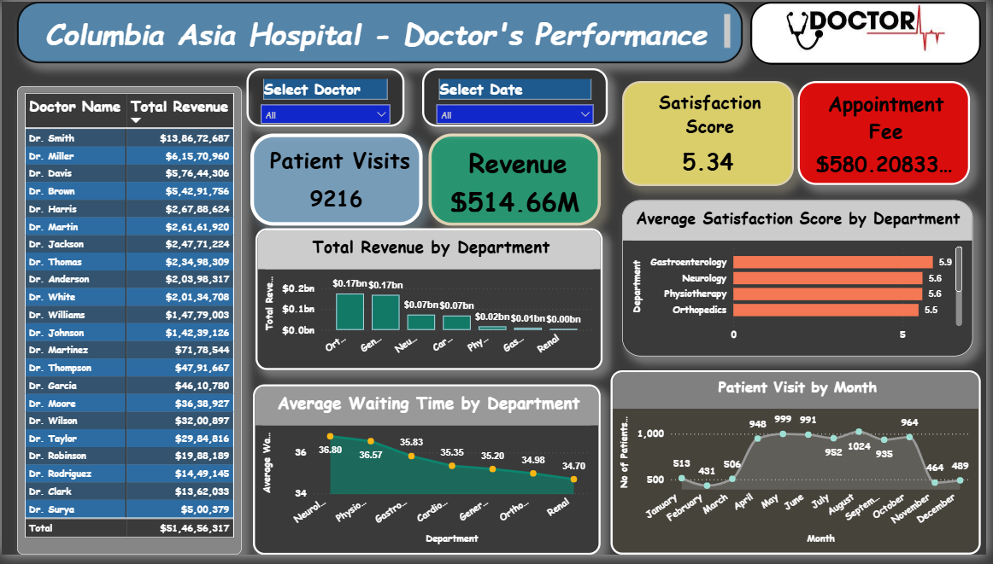

Slide 17
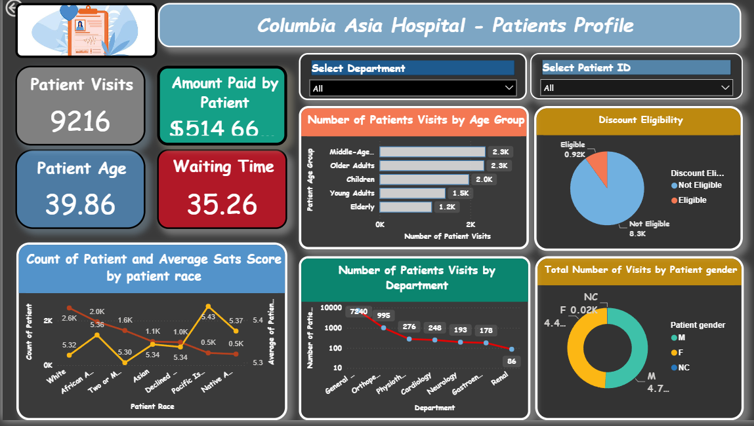

Slide 18
THANK YOU
Columbia Asia Hospital — Power BI Analysis

